Slide 1
Quantum for Portfolio Optimization
Team name: TAMU for Portfolio optimization
Qingtian Miao*, Wenzhou Zhang, Yuhan Wu
*Team leader

Slide 2
Core Objective : find a better ansatz that can give better performance
Compare the different ansatzes’ structure and performance
Key criteria:
Can the ansatz hit the best optimization?
Number of iterations that reach the best optimization

Slide 3
31-Bonds problem
Due to the computational resource limit, we only do experiments on the 31-Bonds problem
We build two new ansatzes:
“TwoLocalxx+Bilinear”
“TwoLocalxx+Smallworld”
Compare the performance of these two ansatzs and the existing known ansatzs: “TwoLocal Full entanglement’”, “TwoLocal Bilinear entanglement” and “BFCD Bilinear entanglement”

Slide 4
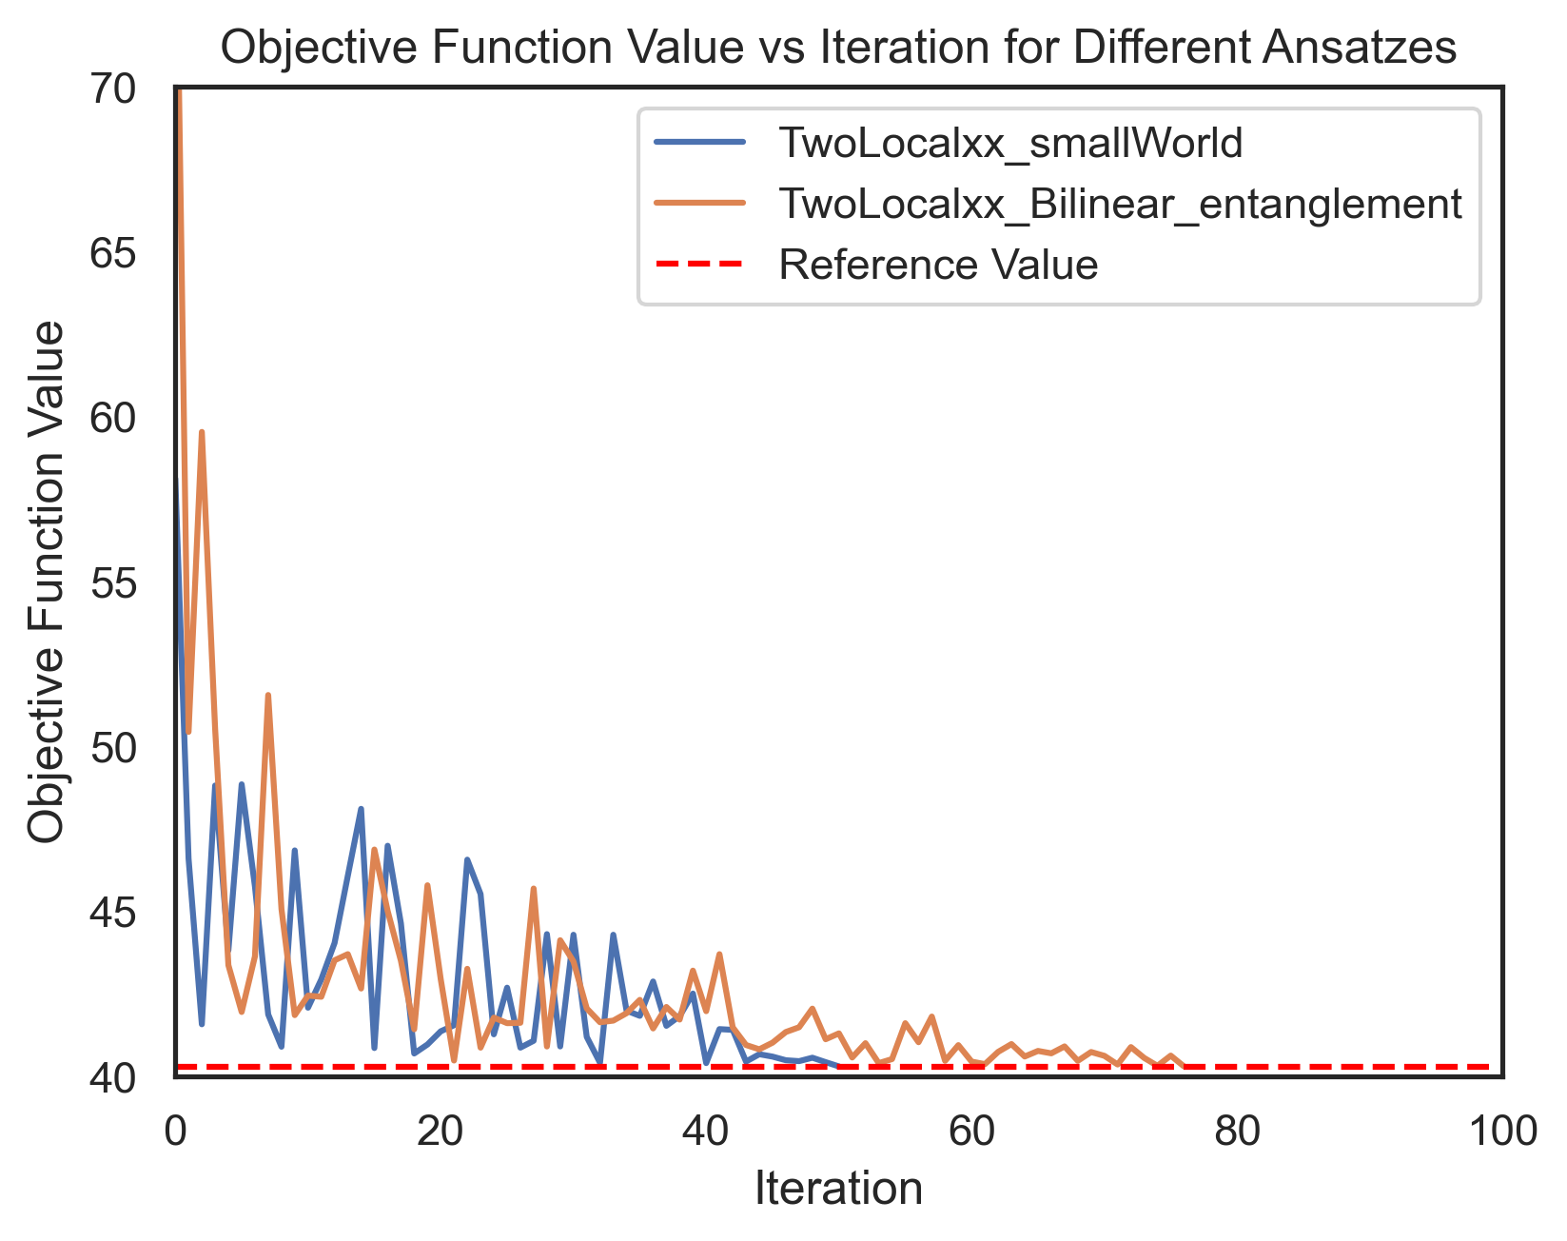
Result
The ansatz TwoLocalxx Biliner can hit the best optimization firstly at iteration=21, and the result will converge after iteration=80
The ansatz TwoLocalxx smallWorld can hit the best optimization firstly at iteration=31, and will converge after iteration =52
Caption

Slide 5
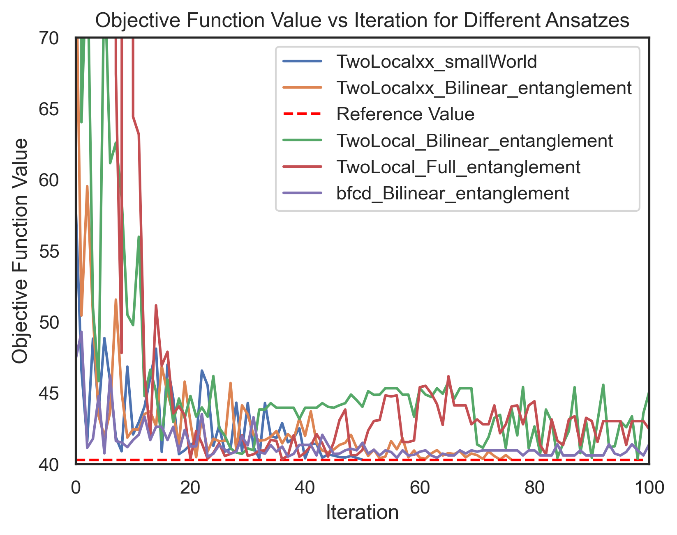
Compare the known results
From the plot, we can see TwoLocal + Bilinear and Full entanglement have a worse performance and didn’t converge to the best optimization within the iteration =100
For bcfd+Bilinear entanglement has a similar speed of convergence as our proposed ansatzs, but it didn’t converge to the best optimization

Slide 6
Parameters setting
# Twolocalxx bilinear entanglement
'1/31bonds/TwoLocalxx1rep_piby3_AerSimulator_0.1':
doe_twolocalxx_common | {
'experiment_id': 'TwoLocalxx1rep_piby3_AerSimulator_0.1',
'ansatz_params': {'reps': 1, 'entanglement': 'bilinear'},
'alpha': 0.1,
},
# Twolocalxx smallworld entanglement
'1/31bonds/TwoLocalxxsw1rep_piby3_AerSimulator_0.1':
doe_twolocalxx_common | {
'experiment_id': 'TwoLocalxxsw1rep_piby3_AerSimulator_0.1',
'ansatz_params': {'reps': 1, 'entanglement': 'smallworld'},
'alpha': 0.1,
},
# TwoLocal full entanglement
'1/31bonds/TwoLocal1repFull_piby3_AerSimulator_0.1':
doe_twolocal_common | {
'experiment_id': 'TwoLocal1repFull_piby3_AerSimulator_0.1',
'ansatz_params': {'reps': 1, 'entanglement': 'full'},
'alpha': 0.1,
},
# Twolocal bilinear entanglement
'1/31bonds/TwoLocal1rep_piby3_AerSimulator_0.1':
doe_twolocal_common | {
'experiment_id': 'TwoLocal1rep_piby3_AerSimulator_0.1',
'ansatz_params': {'reps': 1, 'entanglement': 'bilinear'},
'alpha': 0.1,
},
# BFCD
'1/31bonds/bfcd1rep_piby3_AerSimulator_0.1':
doe_bfcd_common | {
'experiment_id': 'bfcd1rep_piby3_AerSimulator_0.1',
'ansatz_params': {'reps': 1, 'entanglement': 'bilinear'},
'alpha': 0.1,
},

